Slide 1

Olist_Store Project Analysis By Team2

Slide 2
Project analysis slide 2
Olist_Store Project Analysis
Conclusion
Agenda
Olist_Store
Project
Analysis
Members
KPIs
Introduction

Slide 3
Agenda
Introduction
Project KPIs
Conclusion

Slide 4
Monisha A.
Vamsi Krishna
Meet our team members
Arun Thota
Vamsi Krishna
Amit Pawar
Priyaja Nayak
Vishal Kumar
Madhuri Ingale

Slide 5
Introduction
Olist is a Brazilian departmental store (marketplace) that operates in e-commerce segment, but is not an e-commerce itself. It operates as a SaaS (Software as a Service) technology company since 2015.
Created for retail companies that want to sell their products online, either in their own virtual store or in commonly accessed marketplaces in the country.
Founded: Feb 23, 2015
Founder: Tiago Dalvi
Subsidiaries: Tiny ERP · Vnda Ecommerce · Pax

Slide 6
Project analysis slide 3
Olist_Store KPIs
KPI1
KPI2
KPI3
KPI4
KPI5
Relationship between shipping days (order_delivered_customer_date - order_purchase_timestamp) Vs review scores
Weekday Vs Weekend (order_purchase_timestamp) Payment Statistics
Number of Orders with review score 5 and payment type as credit card.
Average number of days taken for order_delivered_customer_date for pet_shop.
Average price and payment values from customers of sao paulo city.

Slide 7
Project analysis slide 5
Weekday Vs Weekend (order_purchase_timestamp) Payment Statistics
1,23,67,88/36,40,884
154.44/152.95
13,664/7275
More payments were made in weekday than weekend
But the average payments are almost equal for weekday and weekend
Maximum payment for Weekday vs Weekend

Slide 8
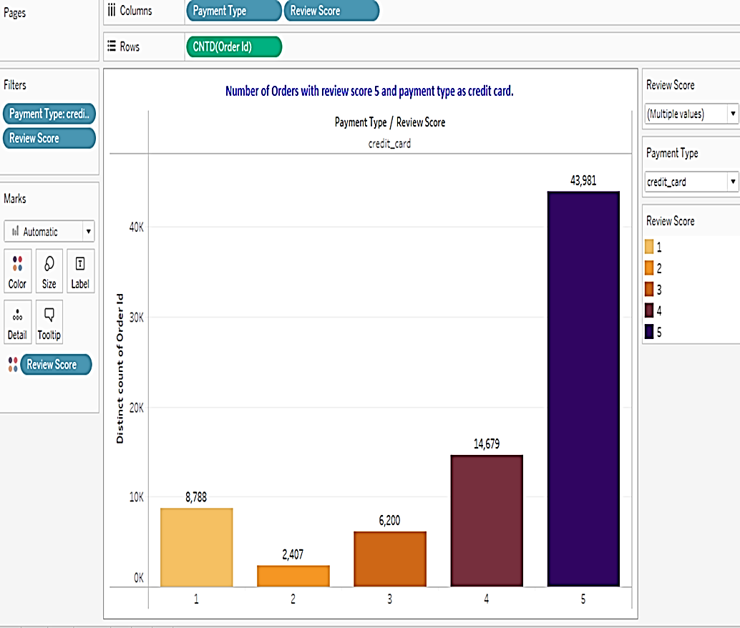
Number of Orders with review score 5 and payment type as credit card
No. of orders with review score 5 is 43,981
No.of orders for review score 2 is 8788 which is the lowest
As the colour becomes deeper the review score increases

Slide 9
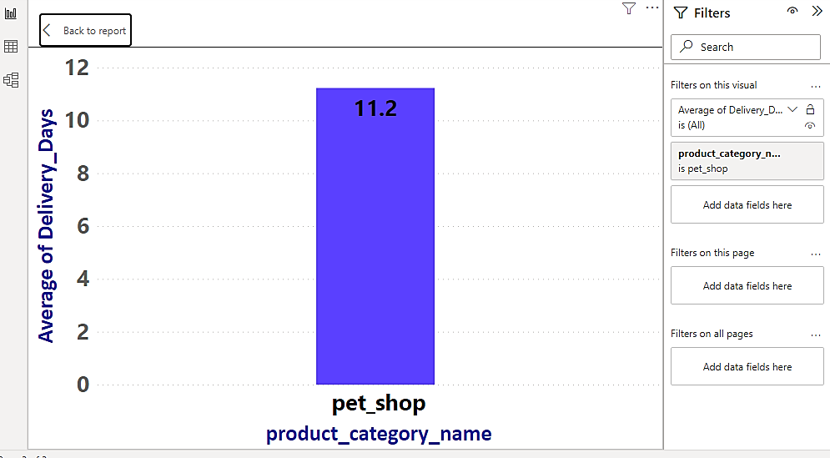
Project analysis slide 10
Average number of days taken for order_delivered_customer_date for pet_shop
The Average no. of days taken to deliver Pet_Shop supplies is 11.37
Delivery Date - calculated as-(Order_Delivered_customer_date) - (Order_purchase_Timestamp)
X-axis –product category name
Y-axis- delivery days

Slide 10
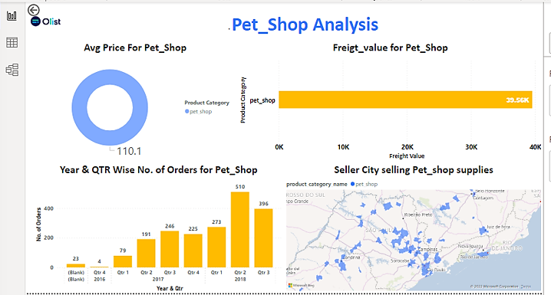
Project analysis slide 7

Slide 11
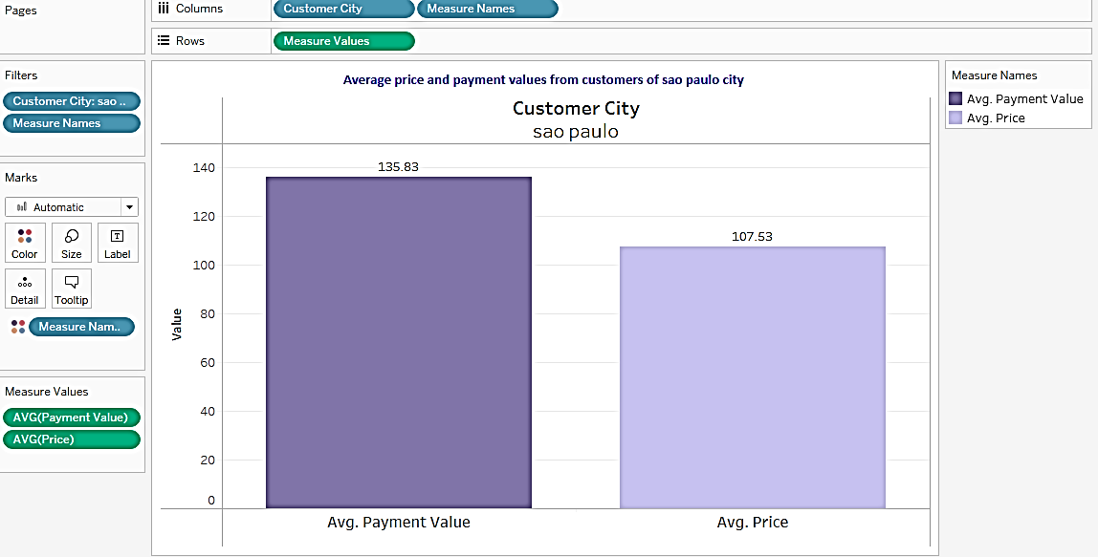
Average price and payment values from customers of Sao Paulo city
Average price for customers of Sao Paulo City is 107.5 Brazilian Real
Average Payment paid by customers of Sao Paulo City is 135.8 Brazilian Real
Hence, the average Profit comes to 28.3 Brazilian Real

Slide 12
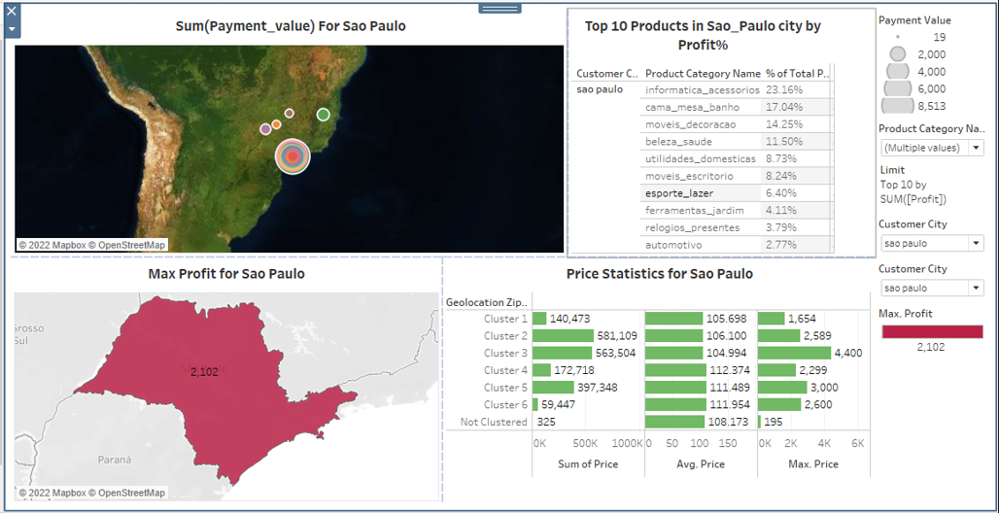
Sao Paulo City Analysis

Slide 13
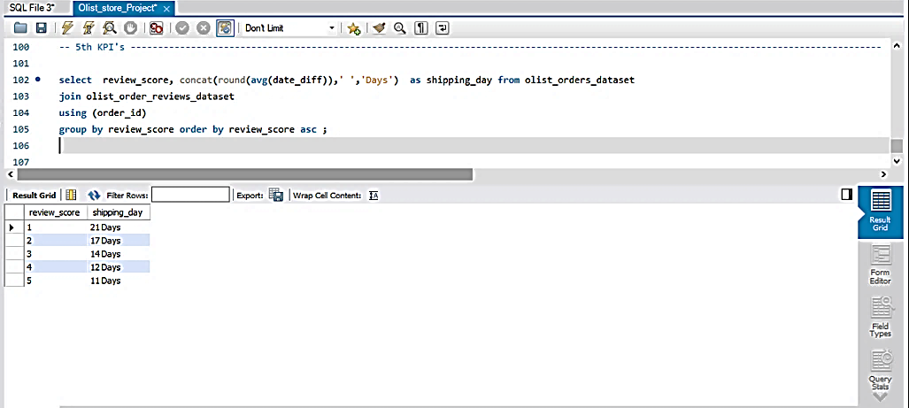
Relationship between shipping days (order_delivered_customer_date - order_purchase_timestamp) Vs review scores
Shipping Days vs Review Scores- Inversely Proportional (Relationship)
Shipping days- Calculated as (order_delivered_customer_date - order_purchase_timestamp)
Most of the orders are delivered in the first 10 days of order purchase

Slide 14
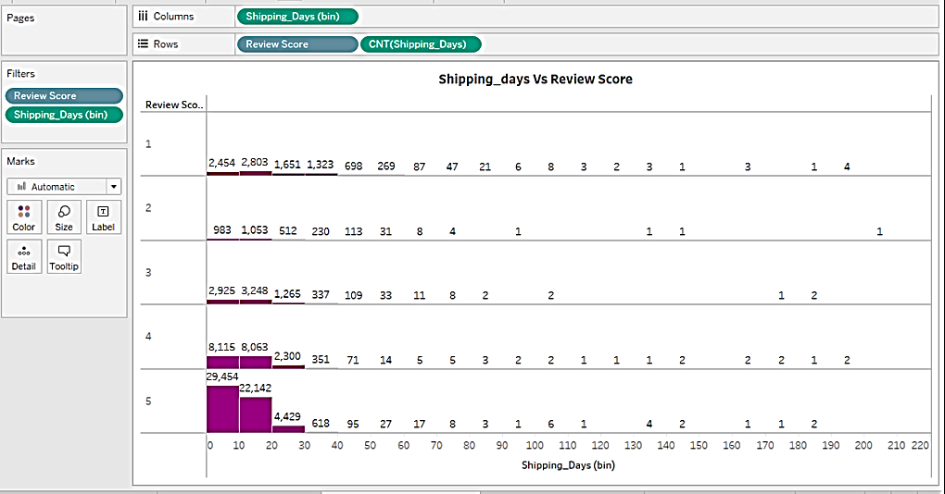
No.of orders for Shipping Days

Slide 15
Project analysis slide 8
SWOT Analysis
POSITIVE
NEGATIVE
STRENGTH
WEAKNESS
Data analysis using Power BI and Tableau was easier
Using Maps to compare geographical data for better statistics.
Data quality and Accuracy
Lack of additional data regarding customer and product
INTERNAL
OPPORTUNITY
THREAT
With better data quality accurate output can be derived
With additional user data like Product ship date or shipping mode we can analyze better
More amount of data could help for forecasting and predictive analysis
Inaccuracy/variation of output due to data quality
EXTERNAL

Slide 16
Conclusion
We have effectively used statistical tools like power bi and tableau to analyze olist_store data based on different KPIs as discussed above
From the above analysis we conclude that:
Weekend payment statistics is more than weekday
Credit card is the most preferred way of payment method by the customers
Effectively manage shipping days to increase review score
Wide range of Product category will have diversified sales strategy
and help in maximizing Profits

Slide 17
Thank You

